Slide 1
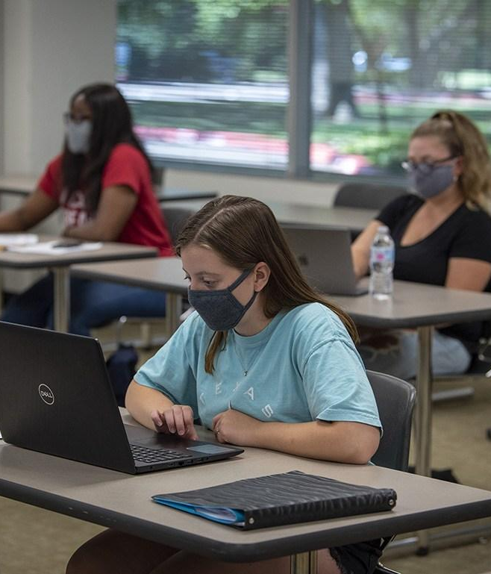
Dual Credit
Presented by
Collin College
Notes:
Hello and welcome. Thank you for coming today.
Happy to see all of you here to learn more about the dual credit program at Collin College
Introduce myself
I am going to cover a lot of material tonight.
After this presentation you will have a better understanding of what dual credit is, the options available to you at Allen HS, and the steps you need to take at Collin to enroll in the program.
If you would, please save any questions until the end of the presentation. I will open it up to questions for the good of the group and then I will be around to answer any specific individual questions you may have.

Slide 2
What is Dual Credit?
A college course that can be used to simultaneously earn high school and college credit in one class!
Notes:
Doesn’t that sound great?
Opportunity to get a jump start on college while you are still in high school!
We want you to be college ready – academically and socially
Courses are rigorous and follow college curriculum, taught by Collin professors
This is the perfect way to get your feet wet and
experience the expectations of a college course while still in HS.
Grades will follow you – transcript-official document
Save time and money and potentially earn up to a year or more of college credit before graduating high school.

Slide 3
Benefits of Being a Collin College Dual Credit Student
Courses may count toward high school credit
Small class sizes
Educational support from Collin College instructors and support services
Experience the college environment and rigor of college courses
Begin a college transcript
Complete a Certificate or Associates Degree
Cost savings
Notes:
Talking point – emphasize the advantage of starting their next step ahead of schedule.

Slide 4
How Much Will You Save?
University of Texas at Dallas
$2,857 for a 3 credit hour course*
University of North Texas
$1,414.54 for a 3 credit hour course*
*Based on Fall 2022 tuition rates
Collin College
is $186
for a 3 credit hour course (for in-county residents)

Slide 5
Dual Credit Courses are Transferable to Most Public
Four-Year Colleges and Universities in Texas.
*Students are responsible for determining if transfer institution will accept their credits*

Slide 6
All About Dual Credit

Slide 7
Is Dual Credit Right for You...
The importance of attendance and time management
College Professors may deduct points for tardiness or absences.
Student code of conduct
Maturity for subject matter and college classroom environment
Students are expected to behave in a respectful manner.
Plagiarism will result in disciplinary action.
Professors are entitled to academic freedoms.
Drop/Withdraw deadlines
Get to know your course syllabus and instructor
Did you take on too much?
Best College Tip!
Notes:
Professors can set their own attendance policies, some deduct points after so many absences
Keep up with requirements in syllabus – readings, assignments, due dates, grading policy-use a planner!
Time mgmt – spend 2-3 hours outside of class reading and studying for every hour you are in class
Be sure to find the right balance between your HS/college course load and extracurricular activities (band, athletics, cheerleading, etc.)
We can talk in generalities to parents about the process for enrollment, but nothing specific about the student’s records at Collin
Students are now adults in our eyes, opportunity for them to learn the college going process and take on new responsibilities

Slide 8
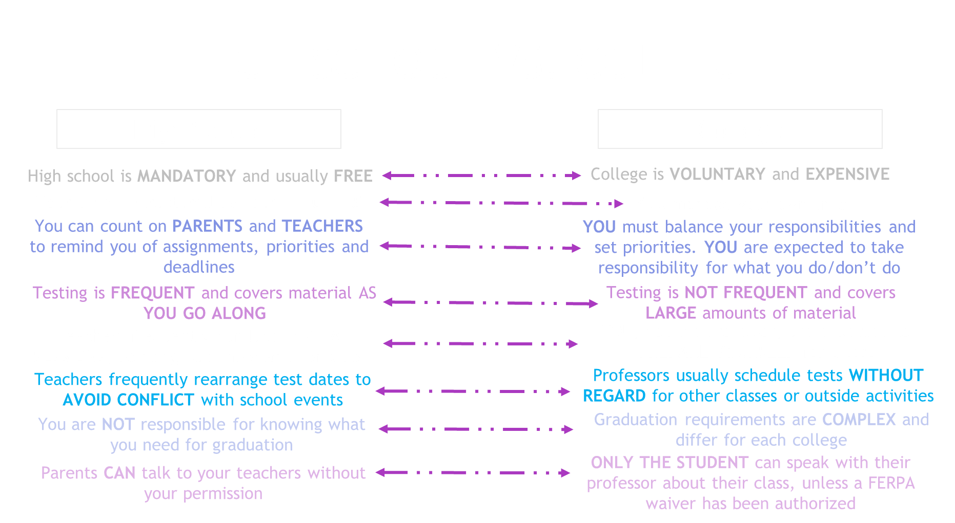

Slide 9
Similar to HIPAA law
Federal law that ensures privacy of student educational records
(begins when student starts college regardless of age)
Collin College cannot share grades, course schedules, or test scores with parents
A great opportunity for students to learn the college process and take on new responsibilities
Students will need to use their Collin email address for communication with instructors
Notes:
We can talk in generalities to parents about the process for enrollment, but nothing specific about the student’s records at Collin
Students are now adults in our eyes, opportunity for them to learn the college going process and take on new responsibilities

Slide 10
Dual Credit Eligibility
Students complete the entire Collin College admissions process
Permission must be obtained from high school counselor before enrollment
Must meet college readiness standards as defined by Texas Success Initiative (TSI)
Students must meet both high school and Collin College academic requirements to continue in the dual credit program
Notes:
You will get a packet from your counselor or here tonight
Remember this is a college course, follow same process as any college student plus permission from your school each semester
C or better to maintain participation in the program, you are beginning a college transcript
Grades earned become part of permanent academic record

Slide 11
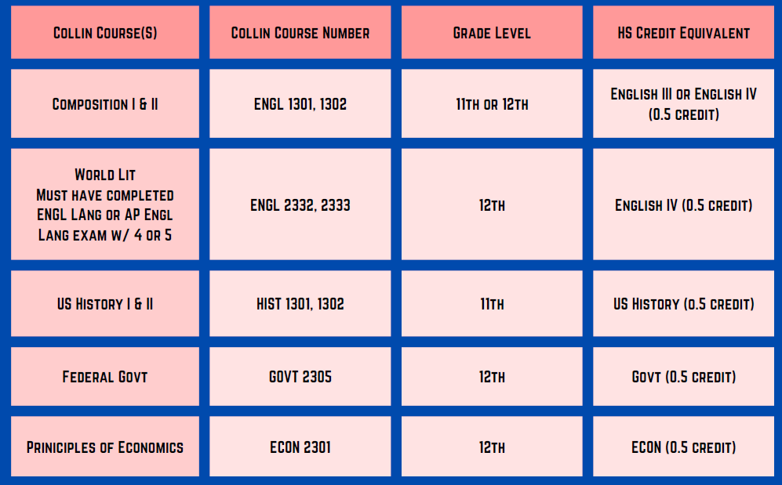
2023-2024 Dual Credit Offerings
Course ID | Course Title
ARTS 1301 | Art Appreciation
BIOL 1406/1407 | Biology for Science Majors I/II
BIOL 1408/1409 | Biology for Non-Science Majors I/II
ECON 2302 | Prin of Microeconomics
ENGL 1301/1302 | Composition I/II
ENGL 2332/2333 | World Literature I/II
GOVT 2305/2306 | Federal Government/Texas Government
HIST 1301/1302 | U.S. History I/II
MATH 1314 | College Algebra
MATH 1342 | Elementary Statistical Methods
MATH 2412/2413 | Pre-Calculus/Calculus I
EDUC 1300 | Learning Framework
SOCI 1301 | Intro to Sociology
SPCH 1311 | Intro to Speech
Courses held at home campus
Academic courses satisfy Texas Core Curriculum
Transferable to most public four-year colleges/universities in Texas
Please check with private and out-of-state institutions for transferability

Slide 12
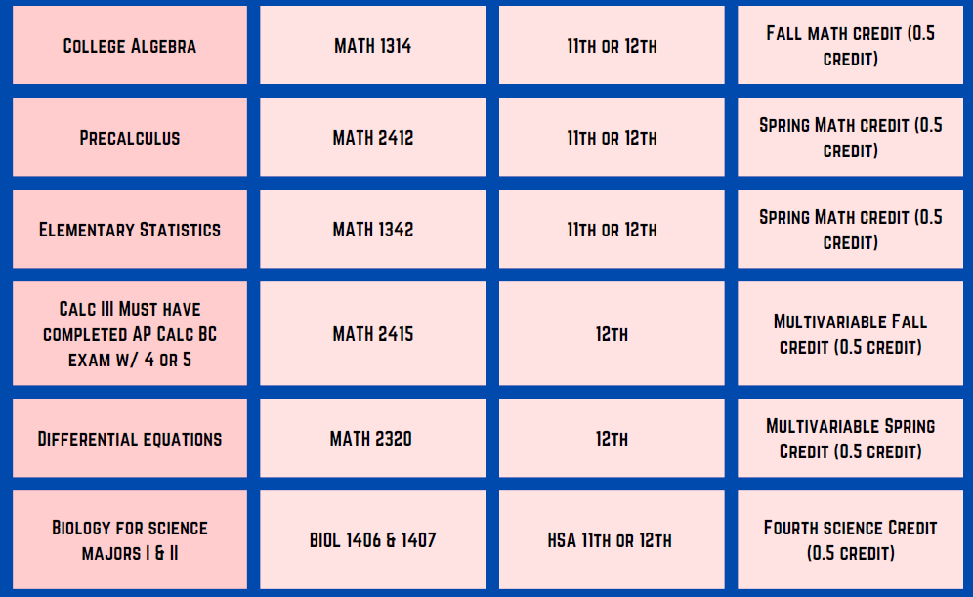
2023-2024 Dual Credit Offerings
Course ID | Course Title
ARTS 1301 | Art Appreciation
BIOL 1406/1407 | Biology for Science Majors I/II
BIOL 1408/1409 | Biology for Non-Science Majors I/II
ECON 2302 | Prin of Microeconomics
ENGL 1301/1302 | Composition I/II
ENGL 2332/2333 | World Literature I/II
GOVT 2305/2306 | Federal Government/Texas Government
HIST 1301/1302 | U.S. History I/II
MATH 1314 | College Algebra
MATH 1342 | Elementary Statistical Methods
MATH 2412/2413 | Pre-Calculus/Calculus I
EDUC 1300 | Learning Framework
SOCI 1301 | Intro to Sociology
SPCH 1311 | Intro to Speech
Courses held at home campus,
Academic courses satisfy Texas Core Curriculum
Transferable to most public four-year colleges/universities in Texas
Please check with private and out-of-state institutions for transferability

Slide 13
2023-2024 Technical Campus Course Offerings
Biomedical Equipment Technology
Electronic Engineering Technology
Industrial Automation
Computer Networking
Computer Aided Drafting
Construction Management
HVAC Certificate
Welding
Courses are held at the Collin Technical Campus in Allen.
Many of the workforce dual credit courses are specialized programs. Please discuss options with the Industries Academy office.

Slide 14
Dual Credit Enrollment Process
APPLY for admission at applytexas.org
Complete assigned holds
Meet TSI eligibility if applicable
Pay for your classes once enrollment has been completed

Slide 15
1. Application for Admission
You may apply online NOW for Fall 2023!
Complete an application at applytexas.org
*Your application must be PROCESSED before your next steps*
Notes:
Free, 20 minutes, no essay
Apply early so you will be ready when registration opens

Slide 16
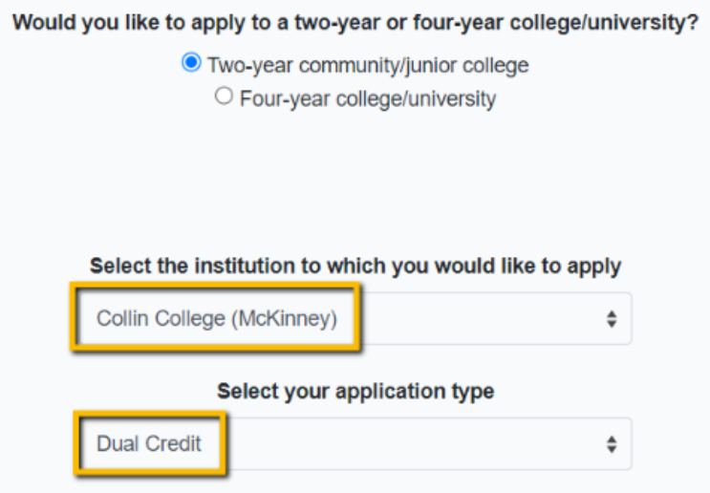
Application Tips
Create an account applytexas.org (students must use personal email address)
Once account has been verified, start a new application
Select Two-year community college
Select Collin College (McKinney) this is the institutional address for Collin College
Residency/tuition is decided based on your answers on the application and the documentation you provide, if requested
Student will receive their Collin ID number (CWID), CougarWeb username and password in 3-5 business days
Questions? Please contact your College and Career Counselor or Special Admissions Counselor

Slide 17
Graduation Dates
Rising Seniors (current 11th grader) – May 2024
Rising Juniors (current 10th grader) – May 2025
Rising Sophomore (current 9th grader) – May 2026
Rising Freshman (current 8th grader) – May 2027

Slide 18
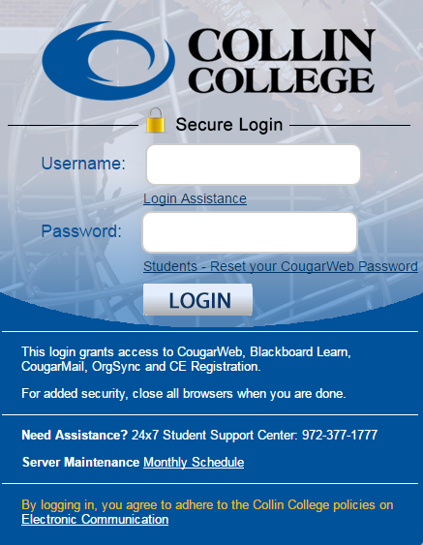
What is CougarWeb?
Students will receive a CougarWeb login 3-5 business days AFTER applications are submitted.
CougarWeb is an online portal that includes all of the information and access to services that students need while attending Collin College.
Online training
Collin Email
Pay your tuition
Access courses (Canvas)
Check Collin College class schedule
Grades
And MUCH MORE...

Slide 19
2. Remove Holds

Slide 20
What is a HOLD?
Each admissions step is listed as a hold, so all steps must be completed prior to student enrollment.
A hold prevents a student from being registered.
Notes:
If parents/students have checklist refer to it here.

Slide 21
High School Approval
Your high school must approve ALL classes, including non-dual credit classes (concurrent).
You must have written approval from your high school to make changes to dual credit classes.

Slide 22
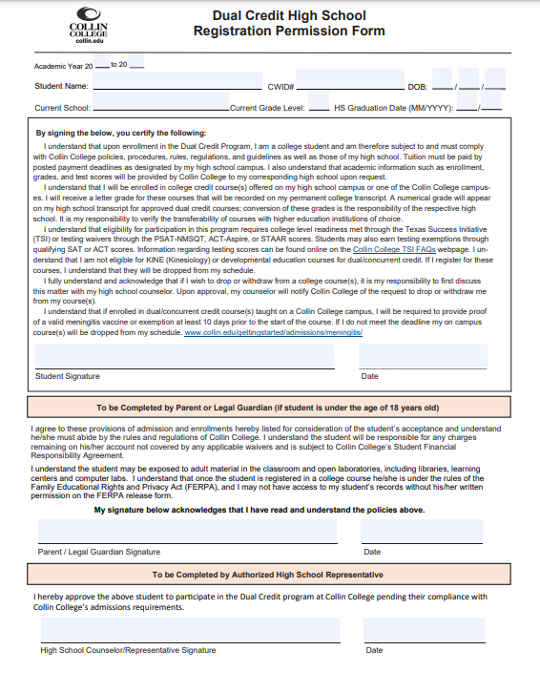
High School Permission Form
23
25
Smith, Jasmine
01
01
2007
100555555
YOUR HS HERE
10
06 2025
Students must have completed the Collin College admissions application and obtain their CWID BEFORE they can submit this form to their counselor.
Student Signature
xx/xx/xxxx
This form can be completed for their entire enrollment period in Dual Credit unless the student needs to apply for readmission.
Parent/Guardian Signature
xx/xx/xxxx
HS Counselor Signature
xx/xx/xxxx
Notes:
Don’t forget the parent signature if they are under 18 years of age!

Slide 23
Texas Success Initiative (TSI)
The TSI is designed to measure college readiness in ELAR (reading and writing) and mathematics.
It is used for course placement purposes.
Students must be at college level in ELAR for the majority of courses.
See the college catalog for placement and prerequisite information: www.collin.edu/academics/catalog.html
Notes:
TSI-Texas Success Initiative
You must be assessed in reading, writing, and math or prove an exemption or waiver

Slide 24
TSI Exemptions
Exemption Scores (minimum scores listed)
Test | Combined/Composite Requirement | Exempts TSI Reading & Writing | Exempts TSI Math
SAT (3/2016 and After) | NO Combined/Composite Score Needed | Evidence Based Reading/Writing 480 | Math: 530
ACT | Composite: 23 | English: 19 | Math: 19
Partial exemptions allowed provided that the required combined/composite score is met.
For more information on exemptions, please review the
Collin College New Student Checklist or visit www.collin.edu/express/dualcredit.
Notes:
Here are a couple of ways you can be exempt from needing the assessment
You just have to have one of these-not all, can be partially exempt, can mix and match, must have composite/combined to use ACT or SAT
We will need proof of your scores-could be on your transcript or sent directly from the testing source

Slide 25
Official Scores Needed
Contact the College Board or ACT student website and have them send your official score report directly to Collin College.
It takes approximately 11-12 business days for Collin College to receive and process them.
ACT Collin Code: 4046 SAT Collin Code: 1951

Slide 26
TSI Waivers
Temporary Waivers for Dual Credit Students (minimum scores listed)
Test | Combined/Composite Requirement | Waives TSI Reading and Writing | Waives TSI Math
ACT-Aspire | N/A | English: 435 | Math: 431
PSAT (After Oct. 2015) | N/A | Evidenced Based Reading/Writing: 460 | Math: 510
STAAR | N/A | English II: 4000 | Algebra I: 4000 and at least a final grade of 70% in Algebra 2

Slide 27
TSI Waivers
Scores must be reported by your high school counselor
For more information on waivers, please review the Collin College New Student Checklist or visit www.collin.edu/express/dualcredit or check with your Collin Counselor or Special Admissions Coordinator

Slide 28
TSI: What Will I Need to Do?
Complete Pre-Assessment Activity (PAA)
Review email from assessments@Collin.edu regarding testing procedures.
Pay at the cashier’s office or online. The cost is $29.
In-Person testing is available at any campus Testing Center by Appointment.
Online testing is offered through a virtual testing platform. The current cost is $40.
Visit our TSI Testing webpage on Collin’s website for more details.
Notes:
Online Testing is available now, please visit the TSI website at Collin.edu.

Slide 29
Bacterial Meningitis Vaccination
Dual Credit students taking classes at any Collin campus MUST provide proof of vaccination within 5 years or documentation of an exemption if they are under the age of 22. The vaccination must be administered at least 10 days prior to start of the student’s entering term.
Dual Credit students taking classes away from a Collin College campus are eligible for an exemption by completing and signing the HS permission form.
For more information, please visit www.collin.edu/meningitis.
Notes:
This is a state law
If you will be taking courses on a HS campus, you can fill out the purple request for exception form in your packet to exempt you from needing the vaccine, turn in to Admissions and Records prior to registration
Remember if you ever take a course on a Collin campus you will need the vaccination

Slide 30
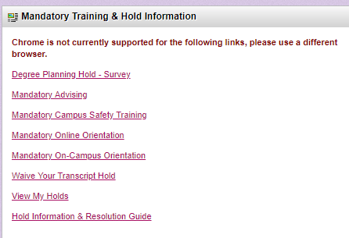
Mandatory Campus Safety Training
Students will be required to complete training prior to registration via CougarWeb.
How to Access Training
Log into CougarWeb account
Go to the Student Tab
Click Mandatory Campus Safety Training
Complete quiz with a 100% score and be sure to click submit at the end
Notes:
Turn in your packets to counselor
Use Look Up Classes to enroll in general population courses on a Collin College campus
Use Add or Drop Classes to enroll in classes on a high school/co-op campus
enter the specific course reference number (CRN)
Be sure to select spring 2016 Credit term
Detailed instructions with dates can be found on your course schedule sheet

Slide 31
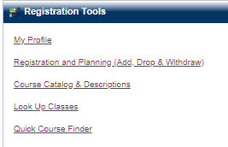
How Do I Check for HOLDS on My Account?
Instructions
Log into your CougarWeb account
Click on My Profile under the “Home Tab” right side of the page.
Click on “Holds” upper right side.

Slide 32
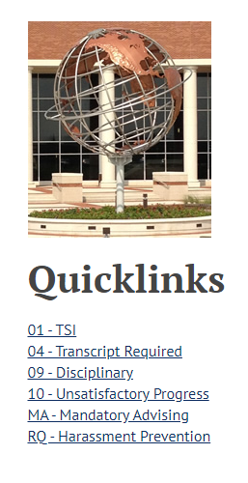
Hold Resolution Guide
Need Assistance with Holds?
Use our Hold Resolution Guide to take care of the following holds:
Did you turn in your Permission Form?
Immunization Proof Required if taking a course on a Collin Campus
TSI Assessment if needed
Campus Safety Video
And others!

Slide 33
3. Registration

Slide 34
Registration Details
For Dual Credit & Concurrent Classes
All students will be registered by the P-12 Partnerships Office beginning Spring 2023
High schools will provide P-12 Partnerships an approved list of students, courses and class periods for registration.
P-12 Partnerships will register and notify students of registration and payment deadline.
Students are responsible for viewing their Collin schedule via Cougarweb and submitting payment by high school stated payment deadline.
Students may not be added back into dual credit courses if dropped for non-payment (based on ISD policy).
Notes:
Turn in your packets to counselor
Use Look Up Classes to enroll in general population courses on a Collin College campus
Use Add or Drop Classes to enroll in classes on a high school/co-op campus
enter the specific course reference number (CRN)
Be sure to select spring 2016 Credit term
Detailed instructions with dates can be found on your course schedule sheet

Slide 35
5. Payment

Slide 36
Tuition
$62* per credit hour for students residing in Collin County
= $186 for a 3 credit hour course
$117* per credit hour for students residing out-of-county = $351 for a 3 credit hour course
Total cost includes a $2 per semester student records fee.
*All fees are subject to change upon approval of the Collin Board of Trustees*
Courses with First Day Access Textbooks will have textbook costs included in tuition fees.
Tuition is paid per semester.
Students eligible for Free/Reduced Lunch will have their cost of tuition waived by Collin College.

Slide 37
Payment Instructions
Log into CougarWeb account
Under Student Quick Links
Click on CougarPay
Click the Collin College Account Suite button
Then click on Make a Payment
Parents can sign up to be an authorized user, so they receive payment emails from business office

Slide 39
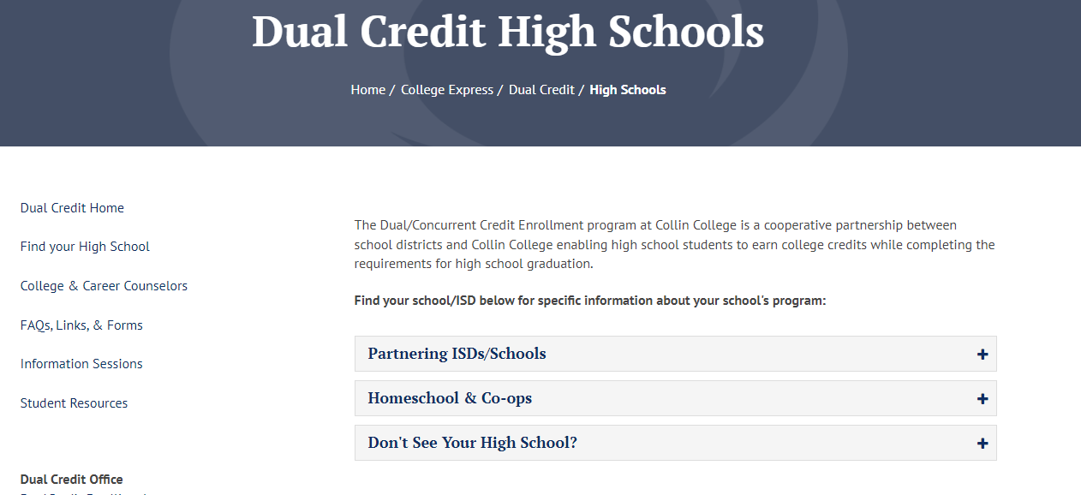
Dual Credit Website
Home Page
Dedicated School Pages
Access to forms and F.A.Qs
Links to dedicated pages for students, parents, and counselors
Important dates and deadlines
Dual Credit benefits
Eligibility and enrollment tips
Application and registration resources
Link to school-specific pages
Notes:
Click image to access homepage.

Slide 40
What Does ACCESS Do?
Provides equal access to the educational opportunities and services for students with disabilities through academic accommodations for those who qualify
Tara Franklin, ACCESS Advisor
Allen Technical Campus – A130G
(972) 553-1161 | tfranklin@collin.edu

Slide 41
To Receive Accommodations
A student must:
Self-identify
Apply separately for services through the Collin College ACCESS office
Provide documentation of his/her disability
Request accommodations each semester for each professor
Tara Franklin, ACCESS Advisor
Allen Technical Campus – A130G
(972) 553-1161 | tfranklin@collin.edu

Slide 42
Campus Resources (No additional cost to students)
Career Services | Student Center
Fitness Center | Tutoring
Library | Writing Center
Math Lab | And More…
Notes:
Awareness of resources – both academic and personal
ACCESS (Accommodations at Collin College for Equal Support Services) provides reasonable accommodations for students with documented disabilities. Contact them if you are needing resources such as extra time testing, if you need a note taker/recorder, test reader, etc…. Remember the requirements are different than they are at the high school level and you are responsible for seeking out their services. Please do so as soon as possible so that they have plenty of time to work with you.
Take advantage of tutoring, math lab, writing center
Free, all campuses
Please come to campus even if taking courses only on site at your high school

Slide 43
Dual Credit Staff
Dual Credit Support
Review and process permission forms. | Process individual student dual credit course schedule changes.
Assist with resolving student account holds. | Communicate dual credit program requirements.

Slide 44
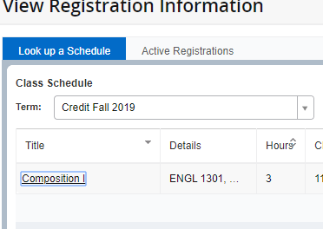
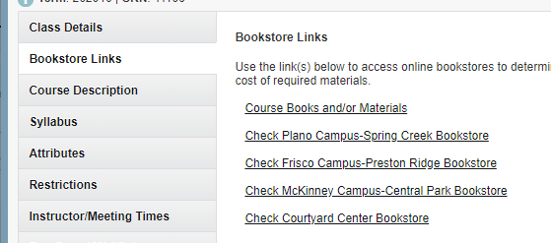
Get Books
You have to buy books in college!
You may purchase or rent books from our campus bookstores. Some books are included in tuition of the course for first day access.
There is also a link on your schedule in CougarWeb.
Log into CougarWeb
Click on My Class Schedule under Student Quick Links
Adjust Registration Term to Credit Fall 2023 if needed
Click the Title of course and select Bookstore Links Tab
Select Course Books and/or Materials
Notes:
Be prepared – books can be more expensive than the class
Encourage you to shop around

Slide 45
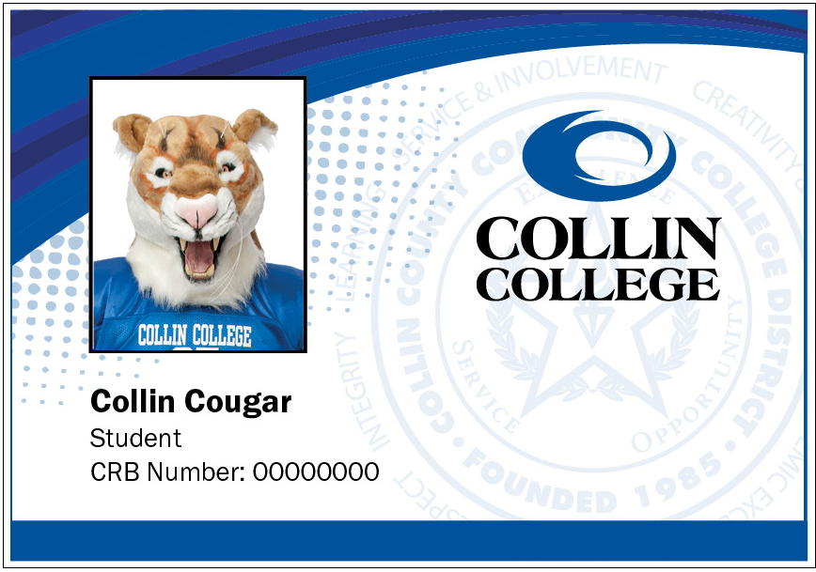
College ID and Parking Sticker
Pick them up from a Student Engagement office on any campus
Both are FREE!
An ID allows you to use campus services
Not a requirement for the first day of class; please pick one up at your convenience.

Slide 46
Fall 2023 Important Dates
Students are encouraged to apply online at ApplyTexas.org now
Dual Credit Paperwork due – May 12, 2023
Must be TSI Complete – May 5, 2023
Payment Deadline – May 19, 2023
Summer classes May 2, 2023 by 7pm
Fall classes May 19, 2023 by 4pm

Slide 47
Questions?
www.collin.edu/express/dualcredit
469.365.1850
dualcredit@collin.edu

